Slide 1
Aspirations of CMI Students to Migrate & Livelihood Transition and Establishment in Springdale, AR
Melisa Laelan, Arkansas Coalition of the Marshallese
Dr. Shanna N. McClain, Environmental Law Institute

Slide 2
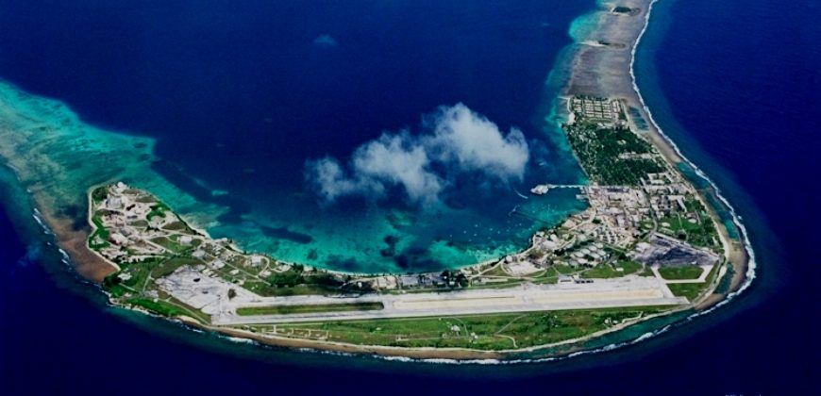
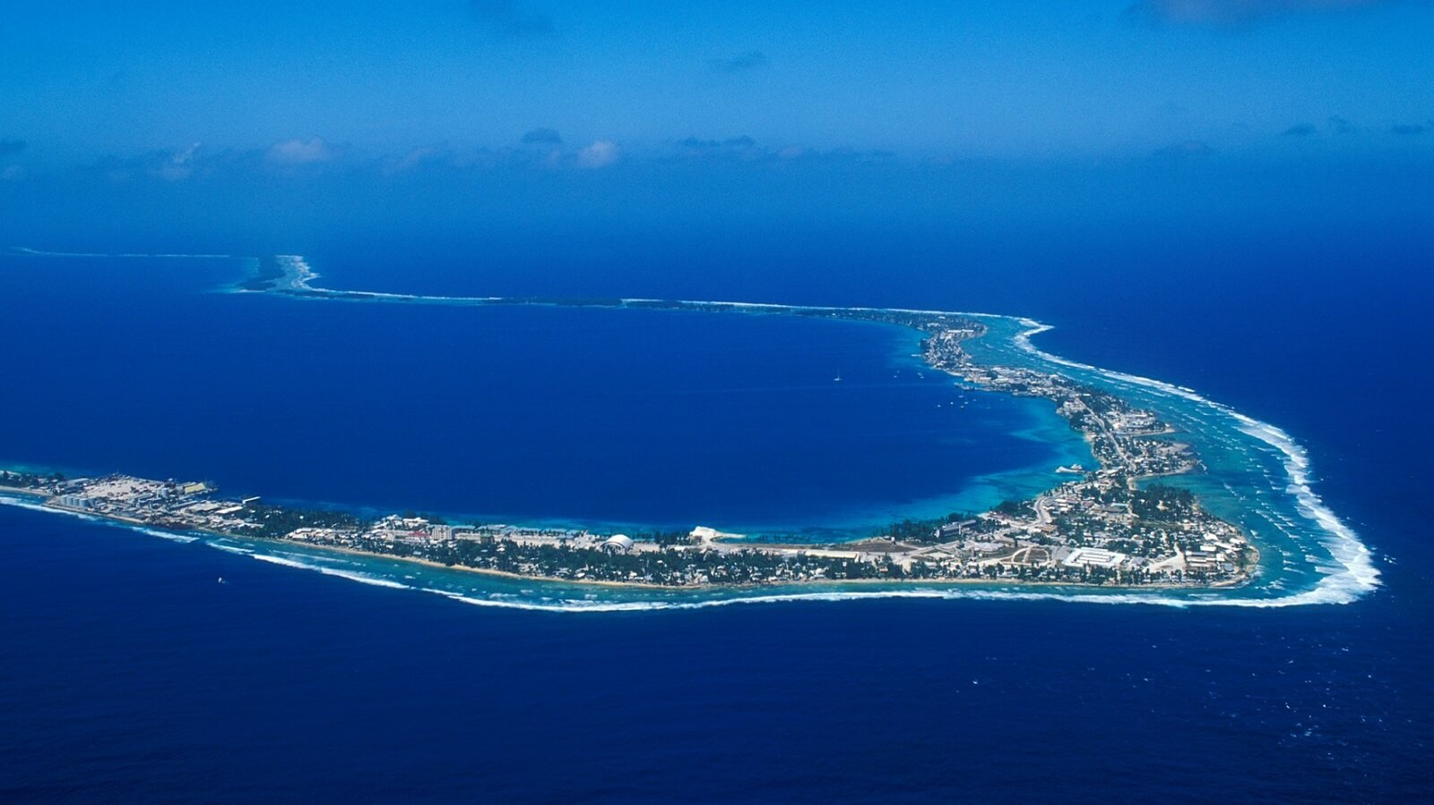
The Republic of the Marshall Islands
Distributed among 5 islands and 29 atolls, combined land area of 70mi²
Approx. the size of Washington DC
1986 Compact of Free Association
Provides for free movement of Marshallese to US and financial aid to RMI
U.S. using lands for security purposes
Marshallese began building Arkansas community in 1980’s
Today, estimated 17,000 reside in Springdale
Other populations in Washington, Oregon, Oklahoma, Hawaii, New Mexico and California

Slide 3
Interviews and Surveys Conducted
CMI Research
Springdale, AR Research
Majuro, College of Marshall Islands
March - April 2018
99 self-completion surveys
Marshallese CMI students
84% in 1st/2nd year at CMI
69% spoke conversational to fluent English
Springdale, AR
June 23 – August 18, 2017
29 structured interviews and 45 self-completion surveys (74 total)
First generation Marshallese
42% some HS, 40% HS diploma , 13.5% some college
51% spoke conversational to fluent English

Slide 4
Reasons for Migration
CMI Students
Springdale, AR
Education 59%
Jobs 20%
Family 12%
Health 4%
Family 36%
Jobs 26%
Education 23%
Health 15%
Springdale Marshallese indicated climate change was not a factor for migration, but indicated they would not return due to climate change.
While 13% of CMI students indicated that extreme weather and SLR were reasons for emigrating, and 95% expected to return to RMI.

Slide 5
Expectations for Migration
80% of CMI Students indicated they intended to move to the United States
54% indicated they would move in the next five years
70% indicated they had family to stay with
92% expected to work upon arrival, and
67% indicated they had the necessary skills to get a job
Comparatively, Springdale respondents indicated
They moved suddenly or within 1 month of deciding (78%)
Moved in immediately with family members or extended family members (90%)
63% indicated it took them less than 1 month to find a job
48% are employed, and 45% are unemployed

Slide 6
Managing Information & Expectations
CMI students’ primary sources of information on emigration and employment come from:
Family
School
Upon arrival, Marshallese in Springdale learned:
High school and college education credits do not transfer at an equivalent level in Arkansas
RMI professional certifications are not recognized in Arkansas
52% of Marshallese in Springdale have a job different from what they went to school for or worked at previously in RMI

Slide 7
Employment in Springdale, AR
Reasons for not obtaining or maintaining employment
Family responsibilities
Lack of appropriate ID or paperwork
Lack of transportation
Arriving to work on time
Understanding directions from supervisors (language)

Slide 8
What Contributes to Quality of Life?
Springdale respondents indicated their quality of life would be improved if before leaving:
They were provided information about what life in the U.S. is like or,
If upon arrival:
They had access to education and job training, or
They were provided with information on
The area / region
Life-skills training (e.g., banking, drivers licenses, legal information)

Slide 9
Options for improving transition
“Upon-arrival approach” to welcoming newly migrating populations in US (e.g., W-2, health and education services, access)
Offering courses on life skills and incentives to take the courses
College reimbursement vs upward mobility
Developing cooperative agreements among universities and technical schools in RMI and in US
Development of educational equivalencies to take place in RMI colleges to facilitate the transfer of education credits and recognition of degrees or certificates

Slide 10
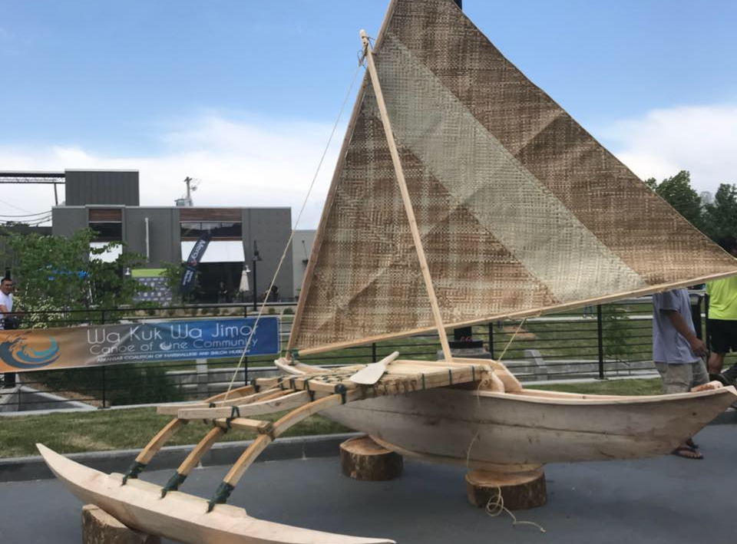
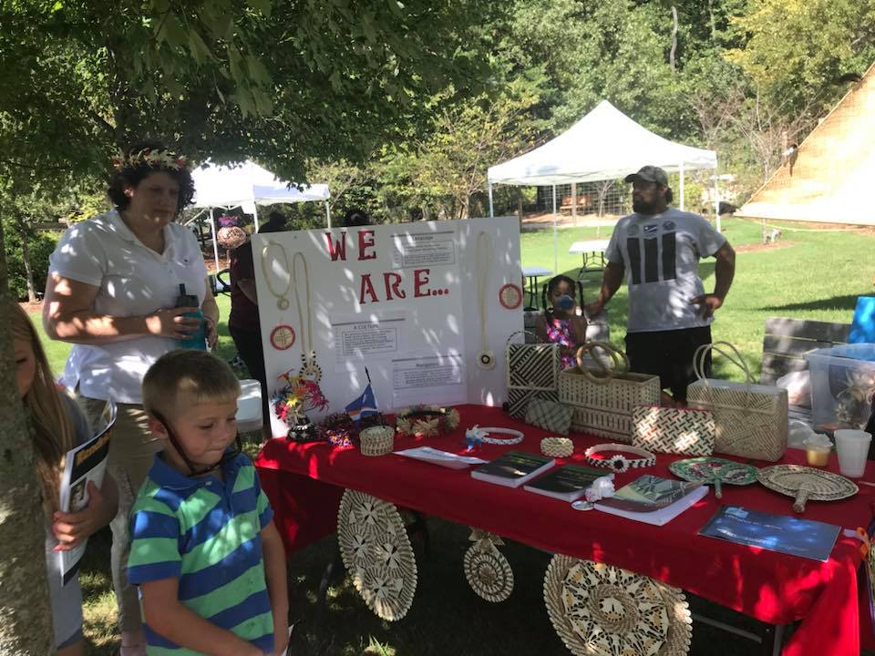
Options for improving transition Community-based initiatives
ACOM-developed pilot on multiple “upon arrival” orientation courses
Driver’s License & Safety Course in Marshallese
Financial/ Banking Education
Youth mentoring/tutoring Programs for newcomers
Culture Education
Social Services
Food Pantry
Healthcare
Legal Document (passport, i-94 form, intra-family adoptions)

Slide 12
mlaelan@arkansasmarshallese.org mcclain@eli.org

