Slide 1
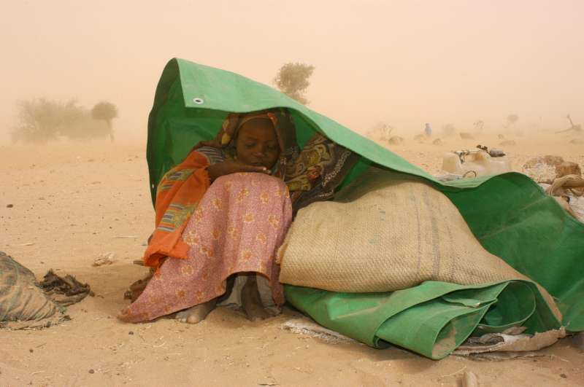
Carl Bruch
September 29, 2016
Photo: UNHCR
Legal and Practical Measures for Environmental Migrants
Carl Bruch January 23, 2020

Slide 2
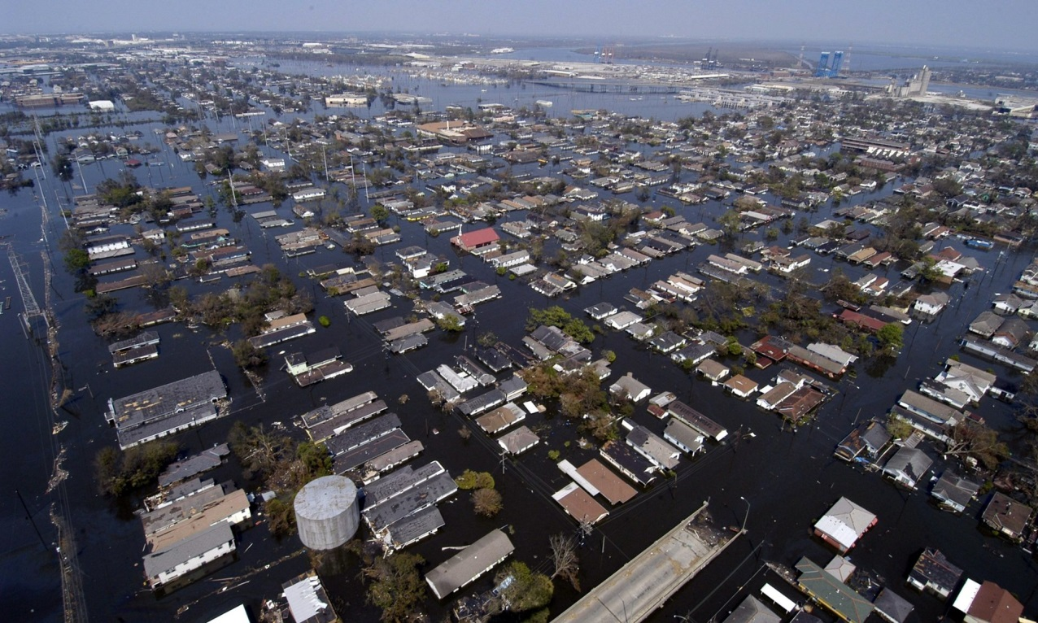
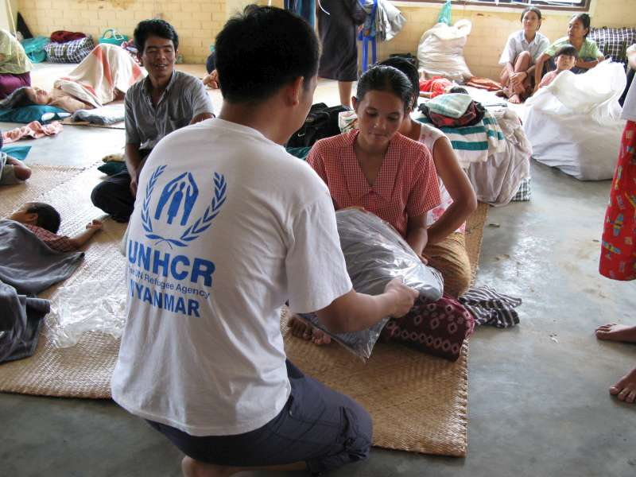
The Context
Millions of people are displaced every year
>25m/year, including
22.5m/year by weather and climate-related hazards
>258 million international migrants
Displacement and migration will increase
Often across national borders
Photo: UNHCR
Notes:
Between 2008 and 2014 a total of 184.4 million people were displaced by sudden-onset disasters, an average of 26.4 million people newly displaced each year. Of these, an annual average of 22.5 million people was displaced by weather-and climate-related sudden-onset hazards. Others have to move because of the effects of sea level rise, desertification or environmental degradation. (The Nansen Initiative, Global Consultation Report)
Researchers are in consensus that displacement will increase due to worsening environmental conditions and other causes.
The Nansen Initiative has identified at least 50 countries that in recent decades have received or refrained from returning people in the aftermath of disasters, in particular those caused by tropical storms, flooding, drought, tsunamis, and earthquakes.
in 2018 the World Bank said climate change would force more than 140 million people to leave their homes in South Asia, Sub-Saharan Africa and Latin America.

Slide 3
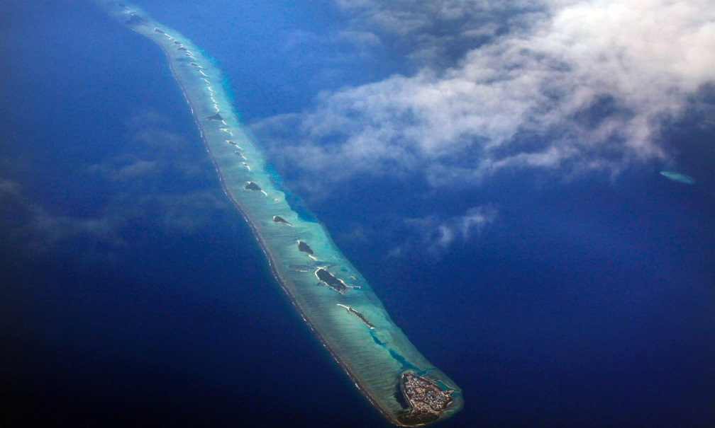
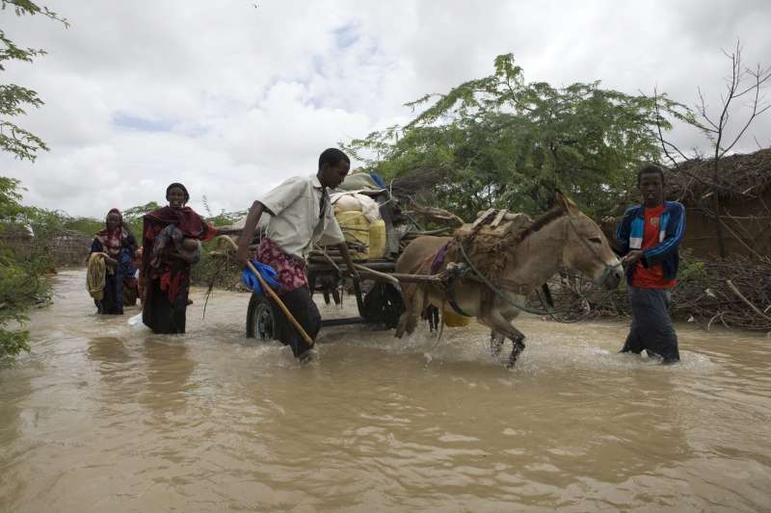
Causes of Climate-Related Movements
United Nations High Commissioner for Refugees:
sudden-onset disasters
slow-onset environmental conditions
the destruction of island states by rising sea levels
uninhabitability of areas due to mitigation and adaptation measures
violence and conflict over resources diminished by climate change
Photo: Reinhard Krause/Reuters
Photo: UNHCR
Photo: UNHCR

Slide 4
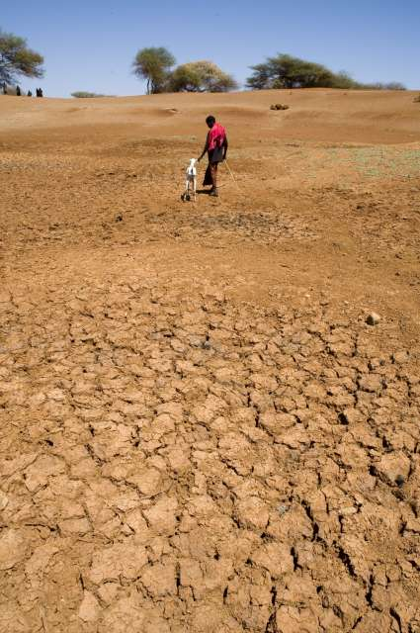
Gaps in Existing International Legislation
International Refugee Law
Requires a well-founded fear of persecution for reasons of race, religion, nationality, membership in a particular group, or political opinion
Non-refoulement forbids the return of persons to places that threaten their life or freedom
International Environmental Law
International Human Rights Law
Potentially promising
Photo: UNHCR

Slide 5
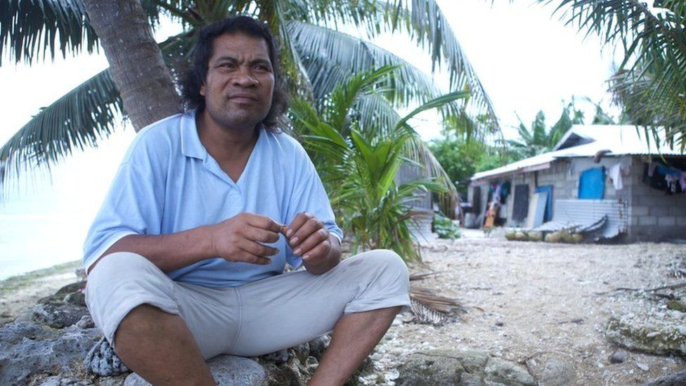
Teitiota v. New Zealand (UN Human Rights Committee)
Challenging forced return to Kiribati
Human rights (not refugee) law
International Covenant on Civil and Political Rights, arts. 6 (right to life), and 7 (freedom from cruel, inhuman, or degrading treatment or punishment)
"Given that the risk of an entire country becoming submerged under water is such an extreme risk, the conditions of life in such a country may become incompatible with the right to life with dignity before the risk is realised“ - UNHRC
BUT: Did not show irreparable harm that is real, personal, and reasonably foreseeable (10-15 years in the future is too far)
→ Finding for New Zealand
Notes:
5
Non-binding ruling by UN Human Rights Committee
https://www.bbc.com/news/world-asia-51179931
South Tarawa, Kiribati
opulation of the island increased from 1,641 in 1947 to about 50,000 in 2010, because rising sea levels had made neighbouring islands uninhabitable. This had led to social tension, unrest and violence, he said.
Mr Teitiota added that crops were already being ruined on Kiribati, and that the island was likely to become uninhabitable within the next 10 to 15 years.
Ruled for NZ (against Teitiota): The UN committee said that, although Kiribati is at risk of becoming uninhabitable, "the timeframe of 10 to 15 years, as suggested by [Mr Teitiota], could allow for intervening acts by the republic of Kiribati, with the assistance of the international community, to take affirmative measures to protect and, where necessary, relocate its population".
Interestingly, CNN’s coverage of this case has been faulted on many points:
The Committee didn’t refer to “climate refugees.” John Knox has noted that “there’s a good reason for that: the narrow definition of "refugee” in international law would almost never include those fleeing climate effects.“ The 1951 Refugee Convention defines “refugee” as someone who is unable or unwilling to return to their country because of a “well-founded fear of being persecuted for reasons of race, religion, nationality, membership of a particular social group or political opinion.” However, even those who aren’t “refugees” have the right under the ICCPR not to be returned to a country if doing so would cause a risk of irreparable harm to their rights to life (art. 6) or to be free from torture or cruel, inhuman, and degrading treatment (art. 7)
Second, the Committee didn’t say that those “fleeing the effects of the climate crisis cannot be forced to return home by their adoptive countries.” In fact, it held that New Zealand could send someone back to Kiribati, a country already feeling those effects.
So what did the Committee actually say, and why is it important? Start with the complaint: in 2015, Ioane Teitiota, a national of Kiribati, filed a submission with the Committee arguing that NZ violated his right to life (ICCPR art. 6) by removing him from NZ to Kiribati.
The Committee accepted Teitiota’s claims that there are violent conflicts between claimants to land in Kiribati, freshwater has to be rationed, it’s difficult to grow crops, and most disturbing of all: sea level rise is likely to render Kiribati uninhabitable in 10-15 years.
The Committee also recalled that it has already held that states’ obligation to respect and ensure the right to life extends to reasonably foreseeable threats, which may include environmental harm. [Portillo Caceres v. Paraguay, Aug. 2019]
So why didn’t it decide for Teitiota? Because it has a very high standard: he had to show a risk of irreparable harm under arts. 6 or 7 that’s real, personal (not based on general conditions in the country unless those conditions are extreme), and reasonably foreseeable.
Moreover, it’s generally up to the state (here, NZ) to decide whether such a risk exists, unless it can be shown that its assessment was clearly arbitrary, a manifest error, or a denial of justice. Here, the Committee didn’t find enough evidence to overturn NZ’s decision.
So it seems likely that at the moment, as long as countries are careful to consider the consequences of returning people to countries suffering from climate change, the Committee is unlikely to find them in violation of the ICCPR.
However, it said this deference will change: “without robust national and international efforts, the effects of climate change in receiving states may expose individuals to a violation of their rights under articles 6 or 7,” such that other countries could not send them back.
Moreover, although the Committee doesn’t say so explicitly, the threat of an entire country losing its land to rising sea levels would seem to be the kind of extreme event that would justify relaxing the requirement that the harm be felt individually, rather than by everyone.
So the importance of the decision is not its immediate effect, which is likely to be minimal (as the CNN article notes in its last paragraph), but its longer-term consequences. If the crisis continues to worsen, a similar case in a few years may reach a very different result.
More generally, this decision is another sign that courts are increasingly willing to bring constitutional and human rights to bear on the climate crisis.

Slide 6
Takeaways from Teitiota v. New Zealand
International Human Rights Law applies
“[I]t seems likely that at the moment, as long as countries are careful to consider the consequences of returning people to countries suffering from climate change, the Committee is unlikely to find them in violation of the ICCPR.” -- John Knox, (Former) UN Special Rapporteur on Human Rights and the Environment
Human Rights Committee rulings non-binding
The press got it wrong
Notes:
6
Non-binding ruling by UN Human Rights Committee
https://www.bbc.com/news/world-asia-51179931
South Tarawa, Kiribati
opulation of the island increased from 1,641 in 1947 to about 50,000 in 2010, because rising sea levels had made neighbouring islands uninhabitable. This had led to social tension, unrest and violence, he said.
Mr Teitiota added that crops were already being ruined on Kiribati, and that the island was likely to become uninhabitable within the next 10 to 15 years.
Ruled for NZ (against Teitiota): The UN committee said that, although Kiribati is at risk of becoming uninhabitable, "the timeframe of 10 to 15 years, as suggested by [Mr Teitiota], could allow for intervening acts by the republic of Kiribati, with the assistance of the international community, to take affirmative measures to protect and, where necessary, relocate its population".
Interestingly, CNN’s coverage of this case has been faulted on many points:
The Committee didn’t refer to “climate refugees.” John Knox has noted that “there’s a good reason for that: the narrow definition of "refugee” in international law would almost never include those fleeing climate effects.“ The 1951 Refugee Convention defines “refugee” as someone who is unable or unwilling to return to their country because of a “well-founded fear of being persecuted for reasons of race, religion, nationality, membership of a particular social group or political opinion.” However, even those who aren’t “refugees” have the right under the ICCPR not to be returned to a country if doing so would cause a risk of irreparable harm to their rights to life (art. 6) or to be free from torture or cruel, inhuman, and degrading treatment (art. 7)
Second, the Committee didn’t say that those “fleeing the effects of the climate crisis cannot be forced to return home by their adoptive countries.” In fact, it held that New Zealand could send someone back to Kiribati, a country already feeling those effects.
So what did the Committee actually say, and why is it important? Start with the complaint: in 2015, Ioane Teitiota, a national of Kiribati, filed a submission with the Committee arguing that NZ violated his right to life (ICCPR art. 6) by removing him from NZ to Kiribati.
The Committee accepted Teitiota’s claims that there are violent conflicts between claimants to land in Kiribati, freshwater has to be rationed, it’s difficult to grow crops, and most disturbing of all: sea level rise is likely to render Kiribati uninhabitable in 10-15 years.
The Committee also recalled that it has already held that states’ obligation to respect and ensure the right to life extends to reasonably foreseeable threats, which may include environmental harm. [Portillo Caceres v. Paraguay, Aug. 2019]
So why didn’t it decide for Teitiota? Because it has a very high standard: he had to show a risk of irreparable harm under arts. 6 or 7 that’s real, personal (not based on general conditions in the country unless those conditions are extreme), and reasonably foreseeable.
Moreover, it’s generally up to the state (here, NZ) to decide whether such a risk exists, unless it can be shown that its assessment was clearly arbitrary, a manifest error, or a denial of justice. Here, the Committee didn’t find enough evidence to overturn NZ’s decision.
So it seems likely that at the moment, as long as countries are careful to consider the consequences of returning people to countries suffering from climate change, the Committee is unlikely to find them in violation of the ICCPR.
However, it said this deference will change: “without robust national and international efforts, the effects of climate change in receiving states may expose individuals to a violation of their rights under articles 6 or 7,” such that other countries could not send them back.
Moreover, although the Committee doesn’t say so explicitly, the threat of an entire country losing its land to rising sea levels would seem to be the kind of extreme event that would justify relaxing the requirement that the harm be felt individually, rather than by everyone.
So the importance of the decision is not its immediate effect, which is likely to be minimal (as the CNN article notes in its last paragraph), but its longer-term consequences. If the crisis continues to worsen, a similar case in a few years may reach a very different result.
More generally, this decision is another sign that courts are increasingly willing to bring constitutional and human rights to bear on the climate crisis.

Slide 7
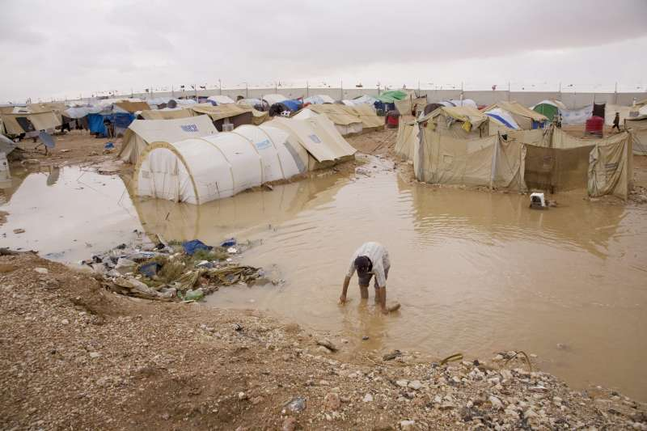
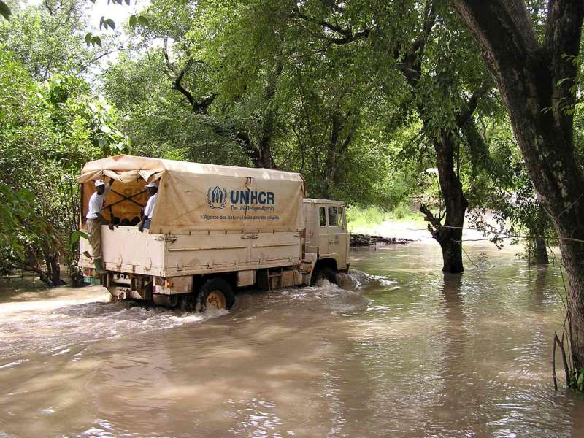
A Climate Refugee Convention?
Difficulties in Negotiating a Climate Refugee Convention
Causation:
Migration is multicausal
Precise role of climate change often unclear
Refugee system already overwhelmed
Uncertainty about the degree of the problem
Hotspots and various degrees of readiness
Photo: UNHCR
Photo: UNHCR
Photo: UNHCR
Notes:
Problems faced by environmentally displaced persons are receiving more attention by the international community, but there are still difficulties in negotiating a climate refugee convention.
Unclear reasons for migration:
It can be impossible to determine whether a person migrates due to climate change or other reasons that may or may not have been caused by climate change, such as scarcity of resources (which could be caused by environmental conditions or poor management or both), conflict (which often arises when resources are scarce), or other reasons (economic, familial, etc). Reasons for migration can also have several causes, such as environmental conditions and economic hardships. Furthermore, according to the World Bank, extreme weather events tend to affect disadvantaged communities disproportionately, pushing 26mil more people into poverty each year. When a tropical storm Agatha struck the Guatemalan coast in 2010, bringing torrential downpours and landslides, poverty rose by 14 percent.
Another reason that states are unlikely to pass a convention right now is uncertainty about the degree of the problem. The need for displacement will depend on individual state’s ability to adopt to climate change and mitigate its effects. Even when persons face dire environmental conditions, they first often try to relocate locally, within their own state or region. It is unclear how many persons will move across borders. There are attempts to undertake additional research to estimate how many persons will migrate as a result of climate change. It is certain, however, that many states will cease to exist due to climate change, as their territory goes under water.
Another reason is that climate change affects different regions to various degrees. Hotspots, areas particularly affected by climate change, are unequally distributed throughout the world. While many countries in Africa and Asia will be hit by climate change the most, many European countries, for example, are predicted to experience fewer effects of climate change. In addition, states have different levels of readiness to adopt to and mitigate climate change. Many European countries are prepared to face the expected effects, while most states in Africa do not have the necessary resources. Consequently, while climate migration is already a serious issue to some states, other states are not yet experiencing this problem and might be less inclined to seek solutions for it.

Slide 8
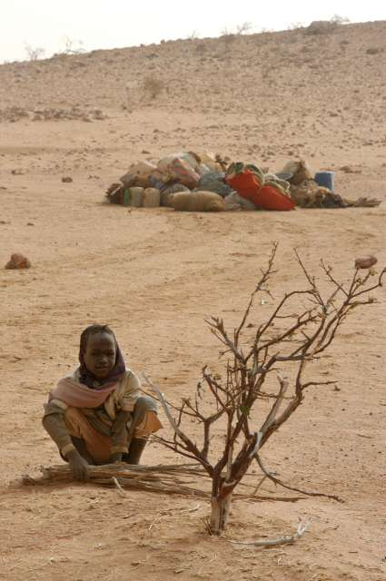
New Policy Frameworks
Global Compact for Safe, Orderly and Regular Migration (2018)
Objective 2 seeks to minimize the adverse drivers of migration, including by “develop[ing] adaptation and resilience strategies to sudden-onset and slow-onset natural disasters, the adverse effects of climate change, and environmental degradation.”
Recognizes the need for legal tools that allow admission and stay of persons driven away by slow- and sudden-onset events.
United Nations Guiding Principles on Internal Displacement (2001)
Non-binding
Photo: UNHCR
Photo: UNHCR

Slide 9
Toward a Toolkit Approach
Value of a toolkit approach
Allows diverse actions at different levels
Increases awareness
Allows flexibility
Opportunistic: empowers proactive action at diverse levels
National; Bilateral; Regional; Global
Build on the Nansen Initiative
Notes:
While a climate refugee convention is unlikely right now, there are other approaches that can be taken at national/bilateral, regional, and global levels. Even small steps to alleviate difficulties faced by displaced persons would help, and a local action can achieve great results.
In addition, national laws and bilateral treaties aimed at helping EDPs (e.g., laws addressing cross-border movement, expedited visas, and resettlement on new lands) might encourage implementation of approaches at regional and international levels. A more informed community would be more inspired to take action. As people become more familiar with the problem and more experienced in dealing with it on a small scale, they might take action more broadly.
The toolkit also addresses the problem of the multicausal reasons for migration, as it allows to take action locally, addressing a particular region or group of people, without reaching an international agreement on who qualifies for protection as an environmentally displaced person. For example, a state can pass a national law allowing preferential access on its territory to citizens of another state (whose territory is disappearing due to rising sea levels, for example), acknowledging that all the inhabitants of that state need help, even though individual reasons for migration might range from severe effects of climate change (flooding), to poor economic conditions, to growing violence in that state, or comprise a combination of several reasons.
It would also allow planned migration from states that will disappear in the near future, but whose inhabitants are not yet displaced. For example, several islands in the Pacific will disappear in the upcoming decades, and all their inhabitants will have to relocate eventually, though right now they are not yet displaced due to environmental reasons. Consequently, they might not qualify as environmentally displaced persons yet, and laws applicable to those already displaced might not apply to them.
The Nansen Initiative
A significant study of the increasingly worsening environmental conditions, increased migration, and approaches to address environmental displacement resulted in several reports published in 2014 and 2015. The Nansen Initiative underscored the existing legal gap in addressing cross-border movement of environmentally displaced persons, since EDPs do not qualify as refugees (climate change/environmental conditions is not one of the protected basis). The Nansen Initiative suggested to review existing legal frameworks at various levels, harmonize them, and consider development of new ones (with emphasis on admission, stay, and basic rights of EDPs moving across borders).

Slide 10
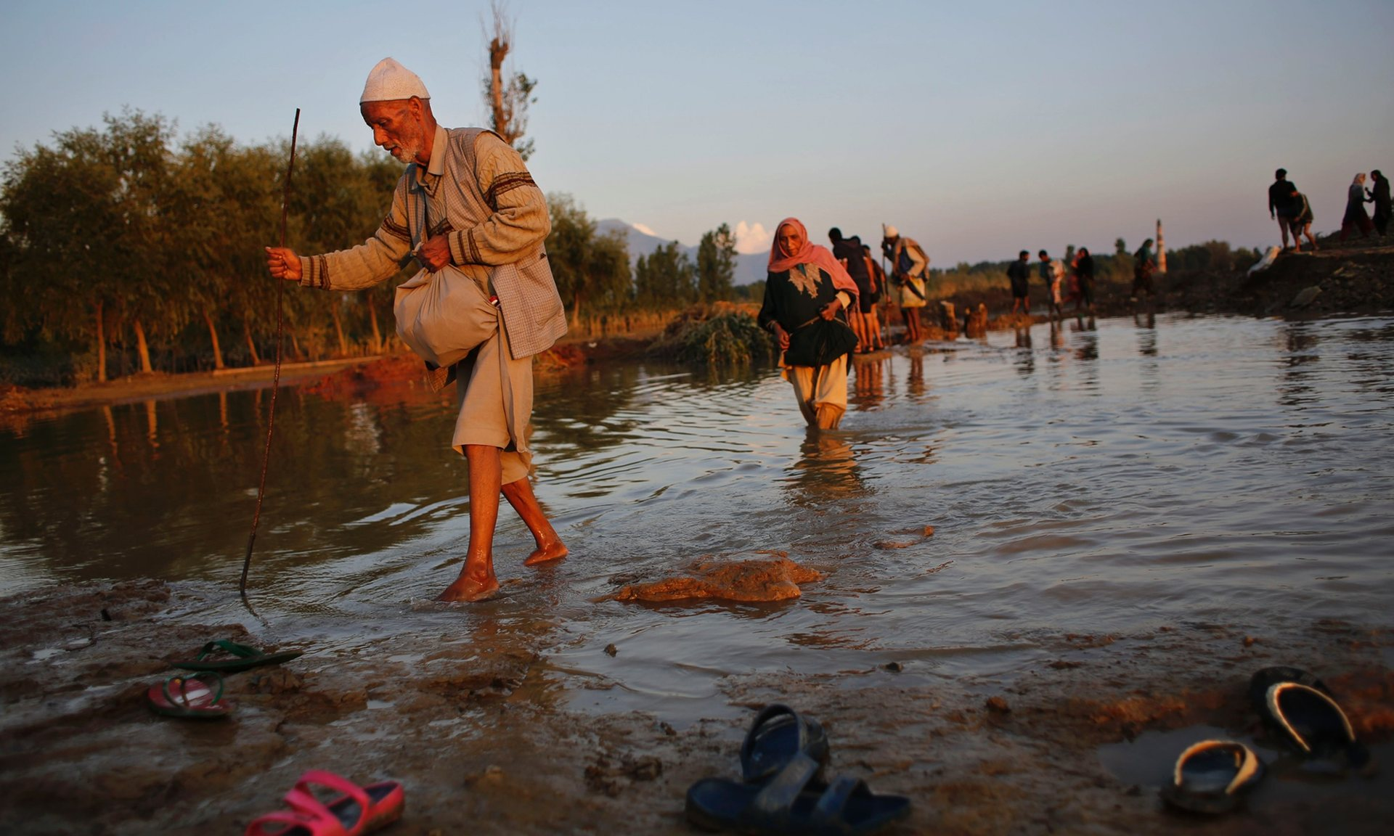
Toolkit of Legal Approaches on Environmental Migration
Right of Entry (national/bilateral)
Extended or Indefinite Stay (national/bilateral)
Rights of Environmental Migrants/Environmentally Displaced Persons (national/bilateral)
[Planned relocation] (regional/global)
[Burden sharing/financial support] (global)
Photo: Altaf Qadri/AfP
Notes:
No visas – no visas for Kiribati to enter Fiji (for 4 months)
Visas for humanitarian reasons – e.g., Swedish Aliens Act, Sec. 4.
Worker visas:
New Zealand’s Recognized Seasonal Employer Limited Visa allows foreigners (preference is given to workers from Pacific states) to enter NZ and work in its horticulture and viticulture industries for up to seven months in an eleven-month period, and Kiribati and Tuvalu can stay for additional two months.
Preferential access to citizens of certain states:
New Zealand’s Pacific Access Category Resident Visa – NZ allows citizens of Kiribati, Tuvalu, Tonga, and Fiji to apply for a resident visa (certain conditions for application must be met), and if their applications are approved, they may enter (must enter within 3 months and family members included on the application must enter within 12 months), live, work, and study in NZ indefinitely. Conditions for application include good health and character, an offer of full-time employment, and minimum English skills. NZ extends this type of Visa to 250 citizens of Tonga, 250 citizens of Fiji, 75 citizens of Kiribati, and 75 citizens of Tuvalu each year.
Laws allowing entry to citizens of former colonies:
New Zealand’s Citizenship Act: residents of NZ’s former colonies (the Cook Islands and Njue) are considered New Zealand citizens with open migration access to New Zealand and access to its social services.
US Compact of Free Association Act of 1985 allows citizens of the Marshall Islands and the Federated States of Micronesia to enter, reside, and work in the US.
Expedited visas:
For EDPs and citizens of certain states that are particularly susceptible to effects of climate change
Access based on displacement:
States can create national laws and sign bilateral agreements that allow entry to persons who have been displaced or are being displaced from their countries of origin due to environmental conditions.
Access based on the country of origin:
States can create national laws and sign bilateral agreements that allow persons affected by natural disasters and climate change to voluntarily migrate in order to avoid displacement at a later stage. This is a preemptive approach that involves creating a list of states that are experiencing severe effects of climate change and are likely to disappear in the future. Citizens of those listed states can then be admitted to other states (preferably on a permanent basis). Planned migration is generally favored, as it does not involve temporary camps associated with emergency migration, which are then replaced by permanent settlement, and allows displaced persons to relocate and assimilate in an orderly fashion. However, the problem with planned migration is that accepting states might only agree with limited/capped migration of EDPs to avoid a large number of immigrants.

Slide 11
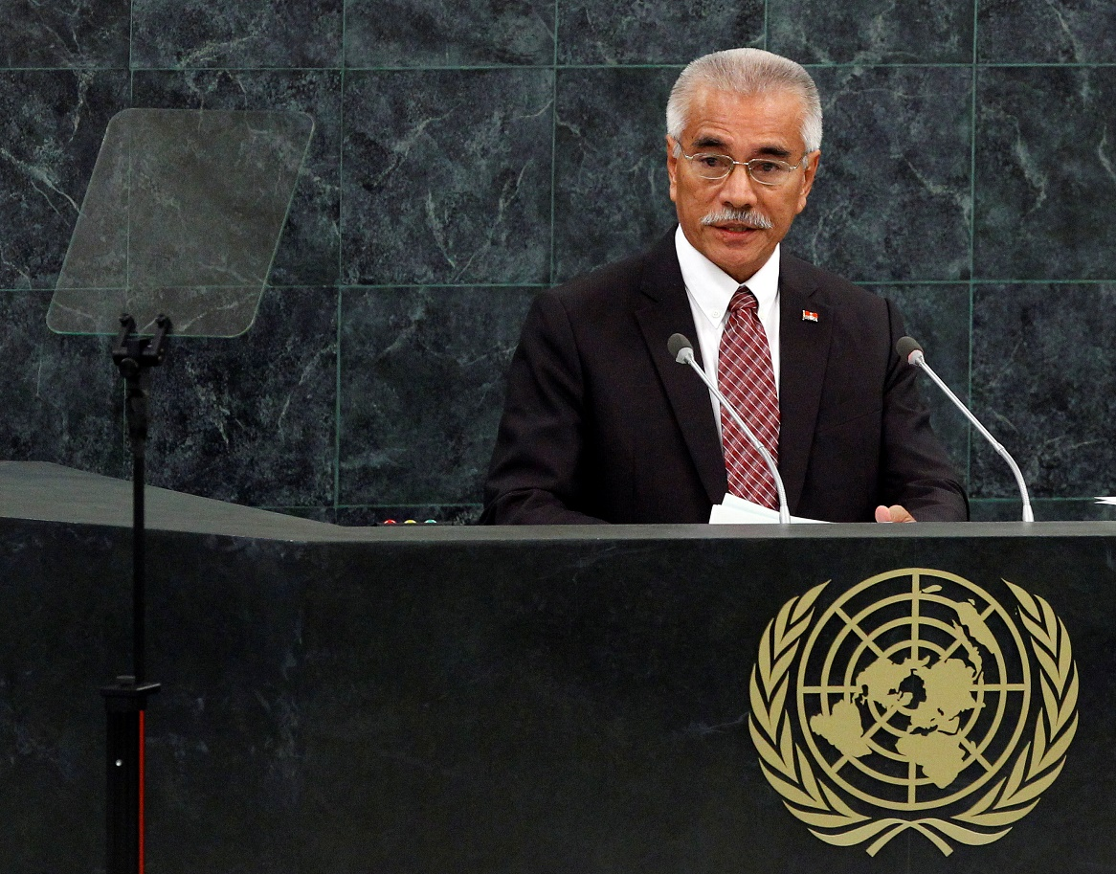
Migration with Dignity
First articulated by Anote Tong, then President of Kiribati
Key elements
Voluntary migration
With the assets and skills to have a life of dignity
Proactive and positive
Notes:
11

Slide 12
Migration with Dignity
What do the terms mean?
“Dignity”
Scope?
Rights
Responsibilities
International agreement
Source?
Legal status?
How to achieve?
Notes:
12

Slide 13
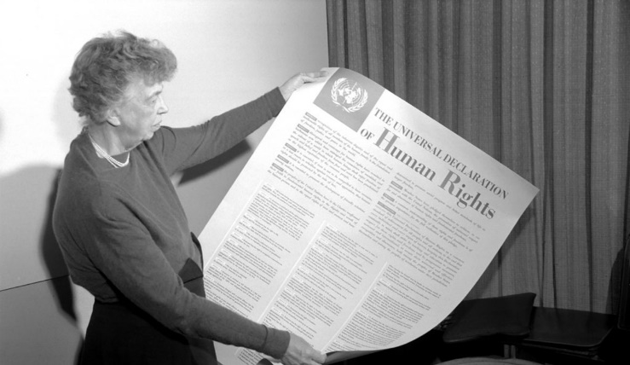
Migration with Dignity
Dignity rights
Globally recognized set of legal rights and fundamental values underlying the very nature of rights.
Emerged from international human rights law
UN Charter
Universal Declaration of Human Rights.
>150 national constitutions contain dignity rights
BUT … no meaningful analysis of what dignity rights mean in the context of migration
Notes:
13

Slide 14
Structuring Migration with Dignity
Illustrative set of dignity rights
Freedom of movement, including the right to choose when to leave and when to return
The right to be secure, free from rape, slavery, torture, and labor exploitation
Right of nondiscrimination, to be treated equally under the law
Livelihoods rights, linked to material well-being
The right to access services, such as health care and education
Civil and political rights, including identity, language, and free speech
Notes:
14

Slide 15
Advancing Migration with Dignity
Next steps
Conceptualizing Migration with Dignity
Based on existing and emerging international law and practice
Consultation
Case studies to validate the Migration with Dignity Framework
Finalizing of the Migration with Dignity Framework
Notes:
15

Slide 16
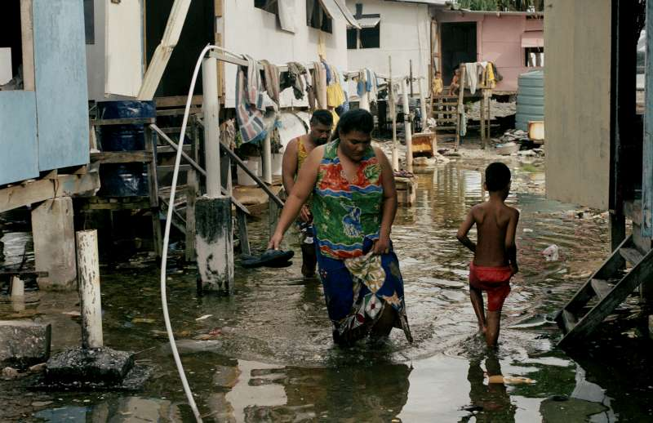
Thank you! bruch@eli.org
Notes:
16
16
16

